Slide 1

Career Quest Engineering
Chéyo Jiménez, MSE
2021-11
Notes:
Behaviors

Slide 2

Why?
Notes:
Since Pandemic I started to feel disconnected with work; I was worried about my career in these times.
I started on quest for quest to make my job more enjoyable.
The behaviors that make work/job more enjoyable are also the behaviors that have greatest positive impact in our careers.

Slide 3

How?
Notes:
Scope
People and Software from same singular system.
Out of scope: The system over time.
Time scale of short to medium term.
Behaviors
We will discuss (3) behaviors groups that helped me feel back in control of my projects and career.
These are things that worked for me and I hope can get something out of these ideas to develop your own behaviors.
Everybody’s context is different. I hope to transmit the general idea which can motivate you to come up with specific implementations.

Slide 4

Flow
Notes:
How is required to get in a state of flow and Scaling the idea of flow experience to apply to career and complex systems.
Motivation, Ability, and the narrative around these.

Slide 5
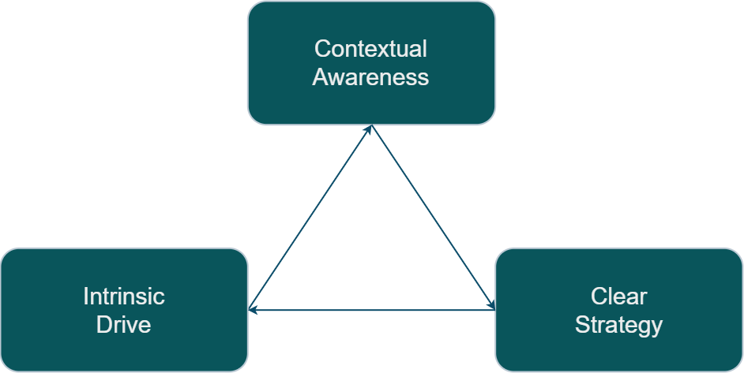
Quest Engine
Notes:
[Contextual] Quest Engine[ering]

Slide 6
Quest Engine
Clear Strategy
[Pre] Contextual Awareness
Intrinsic Drive
[Post]
Contextual Awareness
Notes:
[Contextual] Quest Engine[ering]

Slide 7

Clear Strategy
Create clarity
Set expectations
Expected Impact
Notes:
FLOW
Clear goals. (Know what to do next).
Clear signal of progression towards goals (Tight feedback loop)
Challenging within margin of skill (Not too hard or easy. Just right)
Full control over the activity (Ownership / Authority)
Attribution: Mihaly Csikszentmihályi (1990). Flow: The Psychology of Optimal Experience. https://en.wikipedia.org/wiki/Flow_(psychology)
Clear Strategy
Agile methodology attempts to address this.
Definition of done
User Stories
Iterative progress
Well understood as Ability.
Can I do it?
SMART is an acronym that stands for Specific, Measurable, Achievable, Realistic, and Timely

Slide 8

Intrinsic Drive
Motivation
Mastery
Autonomy
Ownership
Alignment on Directives
Notes:
Sense of Ownership
Feeling of Autonomy.
Mastery (always improving)
Somewhat understood as Motivation
Is it worth it?
Attribution:
Drive: The Surprising Truth About What Motivates Us by Daniel H. Pink 2011
Start with Why: How Great Leaders Inspire Everyone to Take Action by Simon Sinek
Intrinsic Drive
Beyond Mission, Vision statement from company.
Motivation that can only be intrinsic to the individual.
Can not come directly from delegation.
External motivations like money only temporarily boots motivation.

Slide 9

Contextual Awareness
Narrative
Visibility
Measured impact
Confidence
The story
Respecting the opportunity
Quality of life
Notes:
Does it work as intended?
Why and how well is it going?
Measurement: Collapsing the wave function.
Validate actual real world with expected result.
Find valuable opportunities by looking at where and when.
Moving to the right place and executing at the right time.
Temporal
Retrospective, Introspective, Prospective
The act of seeking awareness (as input) across the scalar dimensionality of people, software components, and time.
The act of transporting awareness outside of their contextual environment into the future short term and medium term.
Visibility of work over time.
Somewhat understood as DCog (Distributed Cognition)
Attribution:
Now: The Physics of Time by Richard A. Muller
Distributed Cognition https://en.wikipedia.org/wiki/Distributed_cognition
Cognitive System https://ise.osu.edu/faculty-research/human-systems-integration/cognitive-systems-engineering
https://www.researchgate.net/profile/David-Woods-19 https://github.com/lorin/resilience-engineering#david-woods
Contextual Awareness
Shared awareness of the group
Cognitive Artifacts
Share understanding of the group
Focus on concrete behaviors that somebody can adopt.
Understanding of the inner system. HOw to get understanding.
Cognitive Systems
The trade off of Cognitive Artifacts is that is easier for somebody else to do your job.

Slide 10

Career
Notes:
__ Notes___ - Quality of life - It is not a ladder, it is journey with many folks with different role. - A enginering level is a different job role
According to wikipedia the word career comes from the latin carrus which means chariot. The chariots of our time (cars) are powered by engines. The main purpose of a car is to provide movement in a similar manner that a career is meant to provide progression of one’s profession.

Slide 11

Quest
Notes:
According etymonline the word quest come from the latin root quaere which means “to ask, inquire” and from Old French queste “search, quest, chase, hunt, pursuit; inquest, inquiry”
English words with the same root: request, require, conquest, question, query, acquire

Slide 12
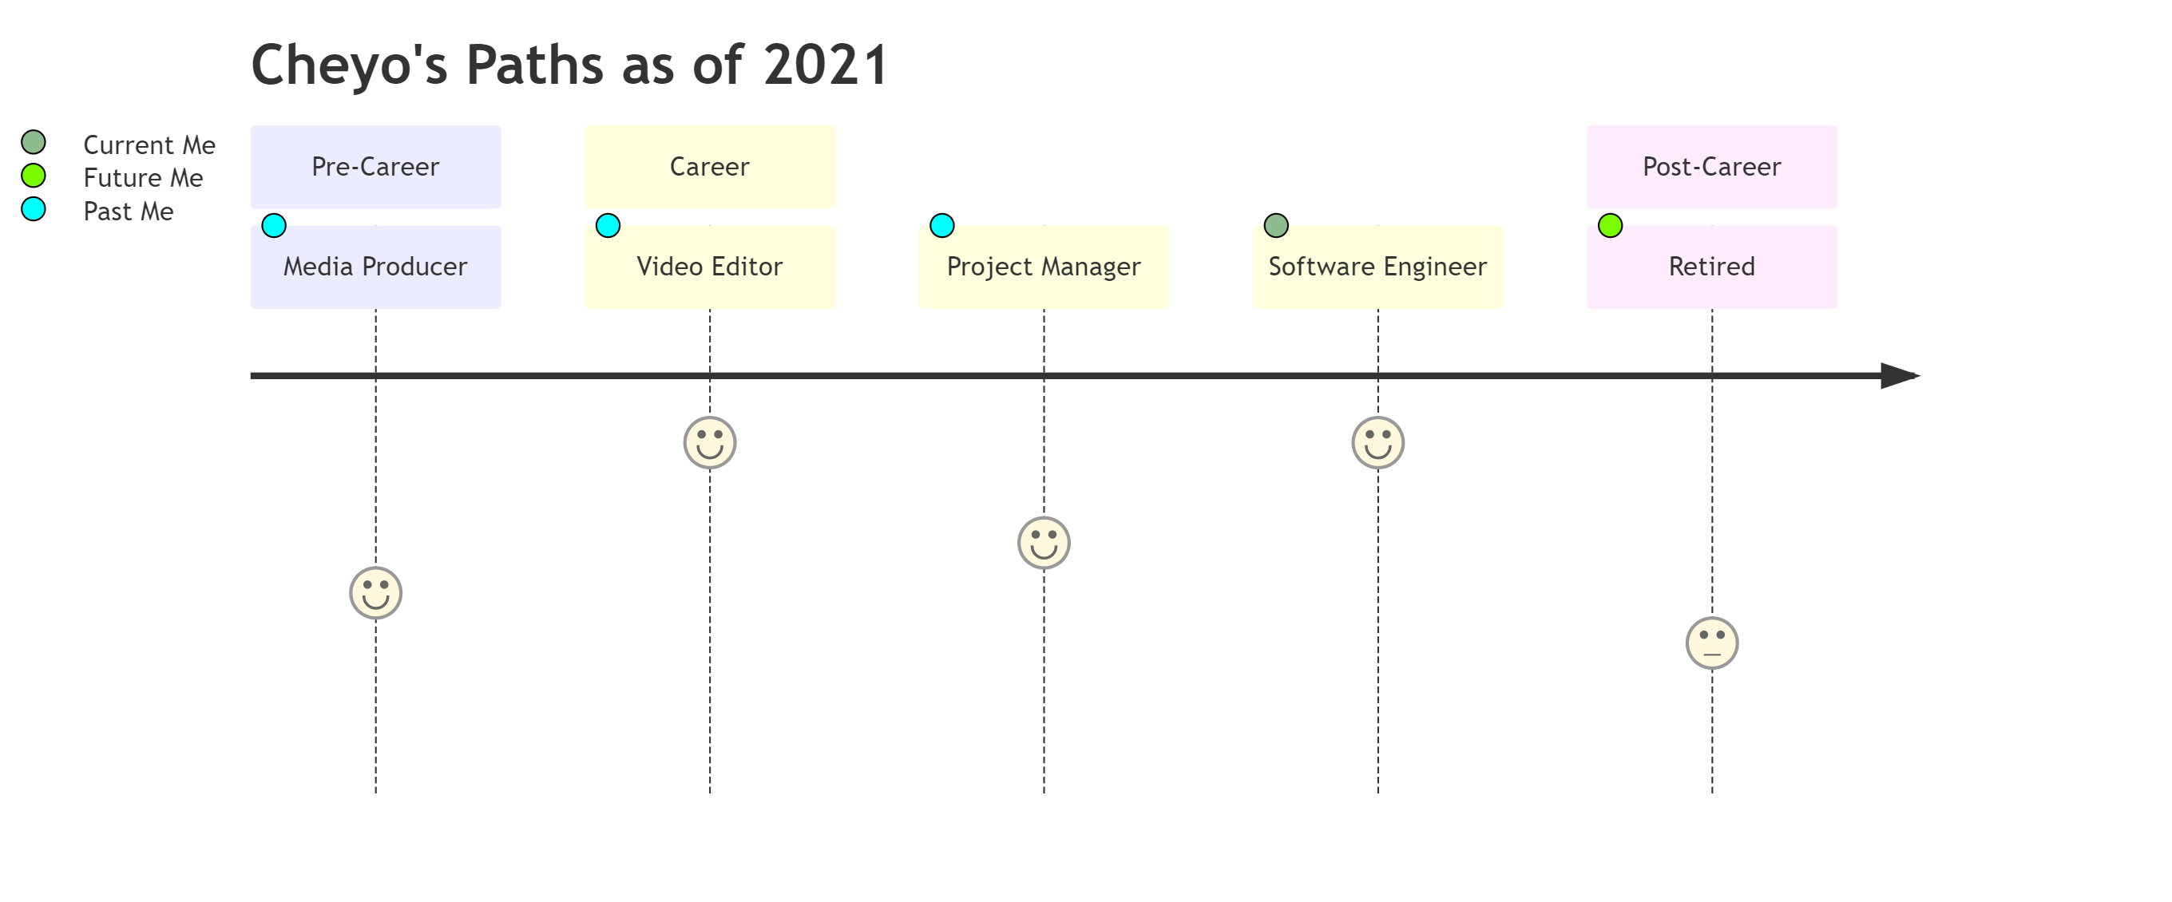
Back[Story]
Notes:
Not included here are college jobs that would not qualify. For example, working at as a package loader motivated me to not want to do that as a career. The same goes for summer helping family with home construction projects.

Slide 13
Summary
Clear Strategy
[Pre] Contextual Awareness
Intrinsic Drive
[Post]
Contextual Awareness
Notes:
Many times that I felt frustrated with my current project, career, or other systems, I need to check which part of my quest engine need a tune up.
Am I laking intrinsic drive? I am need to check my motivations. Do I still want to get better at my craft? Do I have autonomy? Do I want autonomy?
Am I missing contextual awareness? Do I have the context I need to start a job? Have I provided enough context to my co-workers for them to feel successful with the software I created?
Progress is not clear? Do I need to double down in my clear strategy areas? Do I have the information on what I need to do next?

Slide 14

What is your story?

Slide 15
End

Slide 16
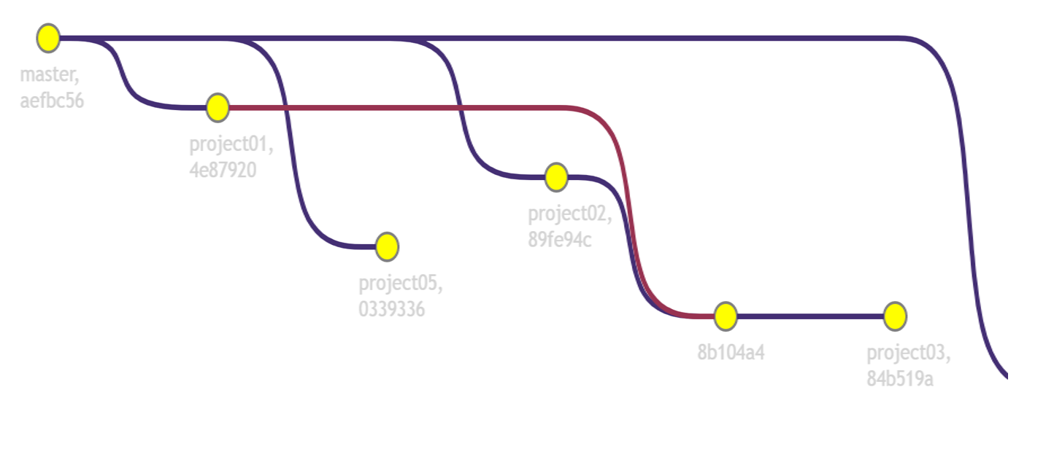
Staging
Notes:
We will start with the individual person and a singular project (component).
We will explore current, short term future, medium term future
We will do a temporal shift to past (current), present (short term), future (medium term)
This part is well understood

Slide 17
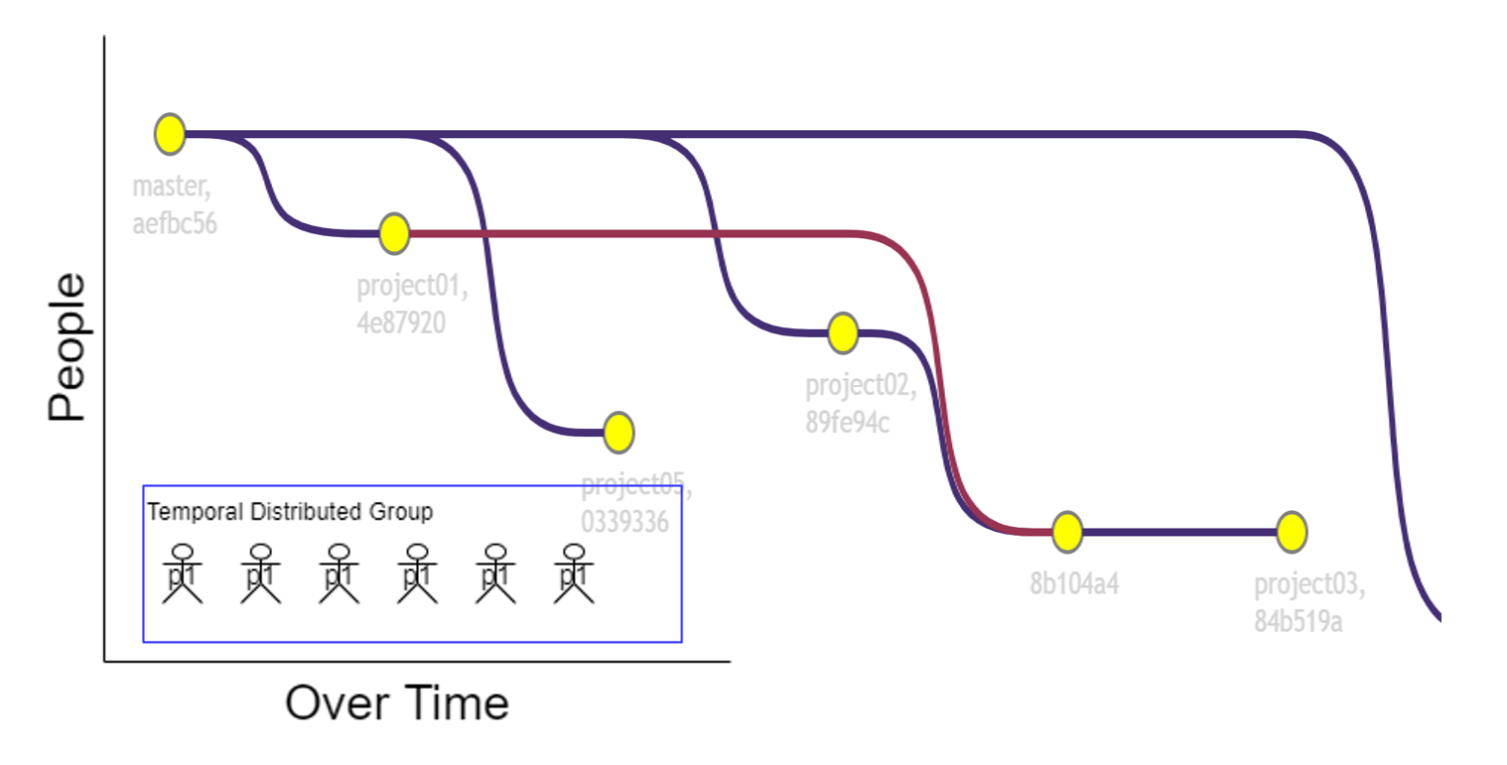
Staging
Notes:
We will continue with the singular person but we will introduce multiple projects at different levels of progress.
Some projects are fun while others are not.
How does this individual feel motivated? (now add a pandemic on top of this)
This part is somewhat understood.

Slide 18
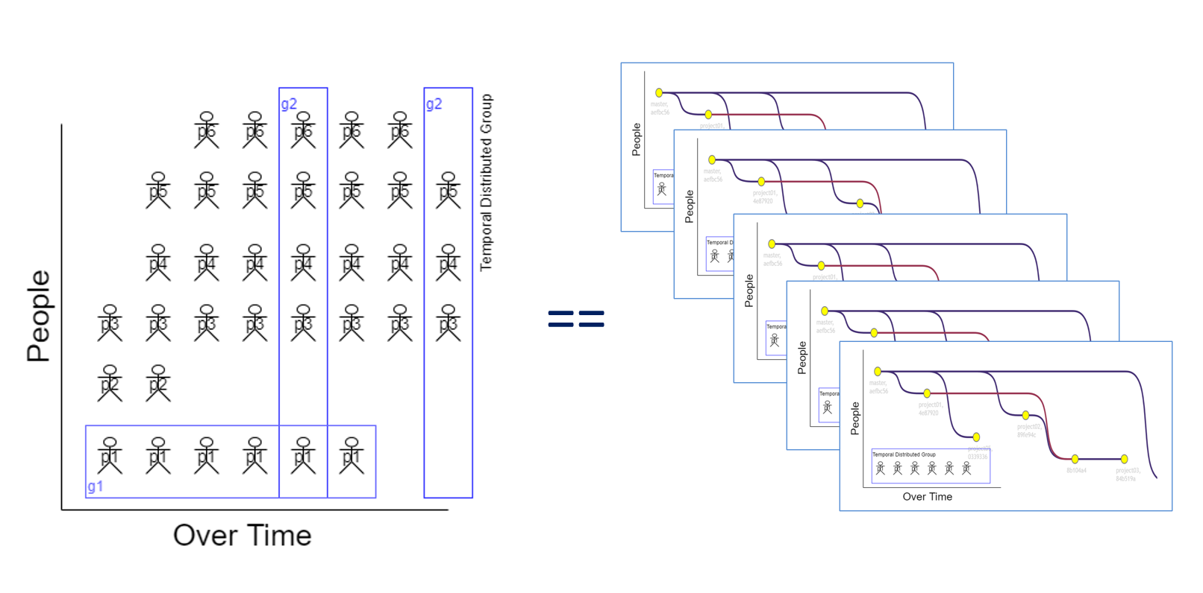
Staging
Notes:
We will imagine a team of individuals (each with different systems of components) that need to interact with each other.
New people being added, and people moving teams, projects changing ownership.
People agents and software agents over time.
This part is somewhat understood.

Slide 19

System
Complex
Notes:
Dimensionality
Nodes (Scalar)
Temporal
Human Agents (Person, Team, System)
Software Agents (Component, Cluster, System)
Time scalar (Short, Medium, Long)
Change is the only constant
Engineering is very interesting in the aspect that while we humans are part of the system that we create, we are also able to create agents to remove toil and pain from our system. (There are trade offs)
Agent grouping distributions
While we have different names for human vs software we will standardize Singular, Group, System
A singular agent across time forms a Group. Temporal distributed group.
Multiple agents that exist with the same temporal short term are a Group. They do not have to be active at the same time but must be available to become active. Temporal Concurrent group (distributed over space)
An agent group (same identity) across time form a System. Temporal distributed system.

